Slide 1

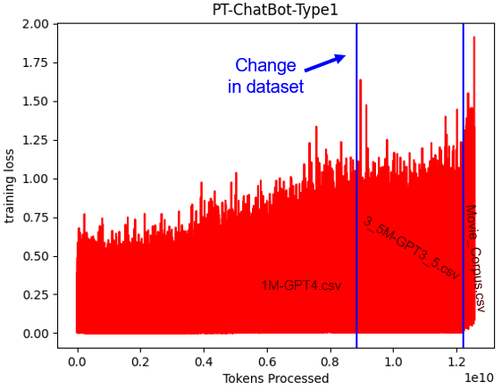
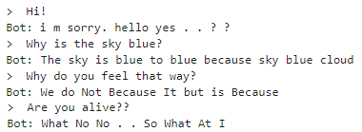
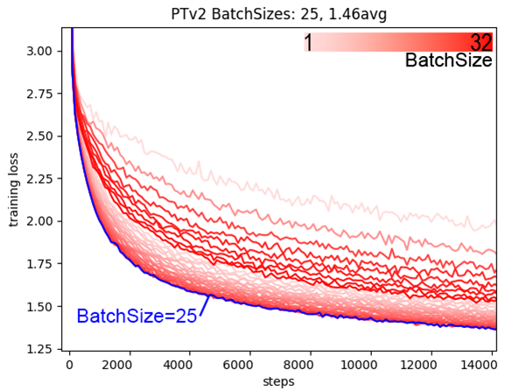
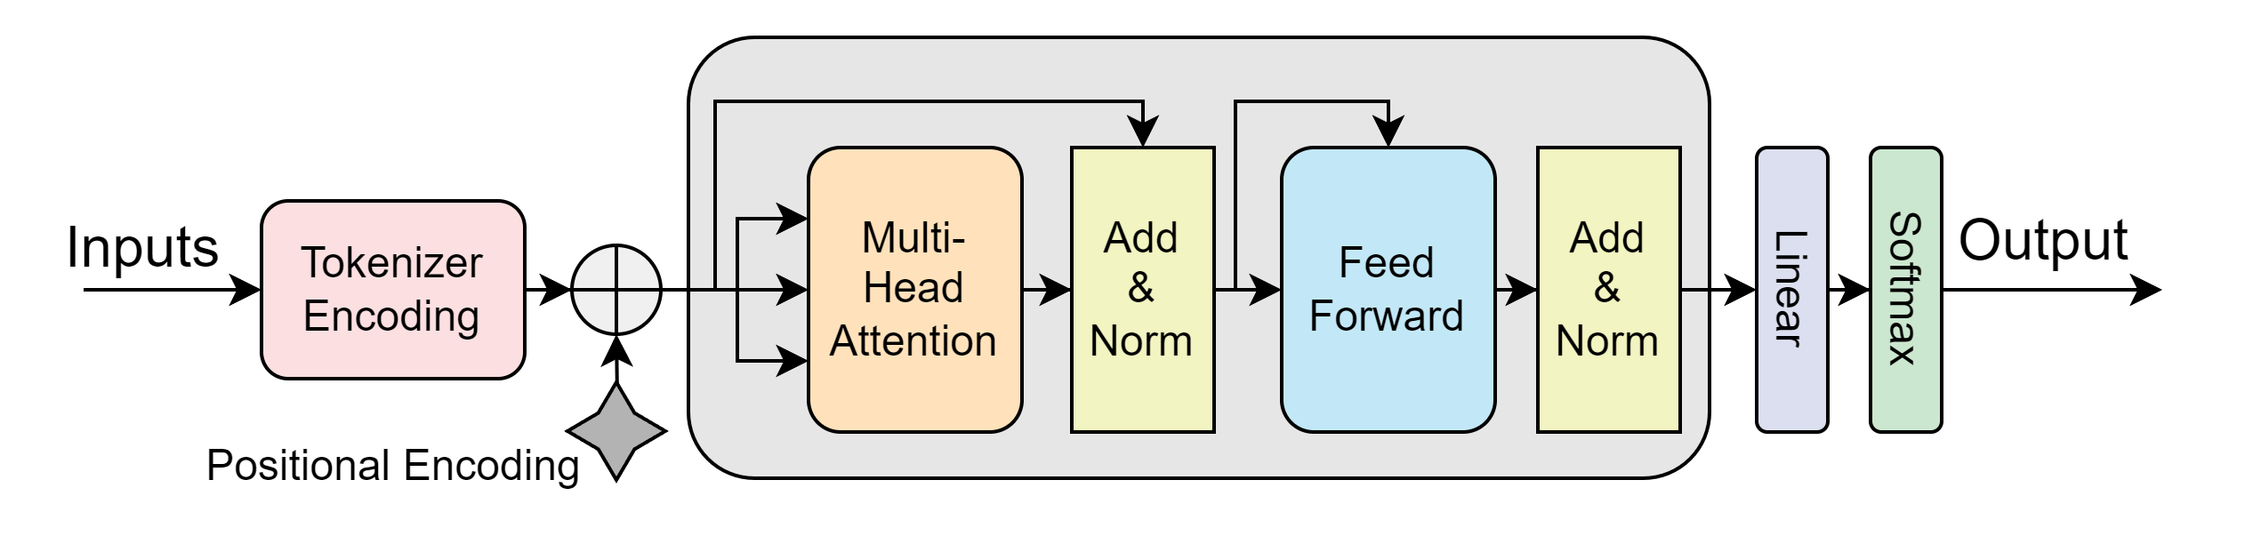
SHREC
SURG
ML/CSV: Prompted Response LLMs
Jonah Belback
2024
EXPO
I. Goals, Motivations, and Challenges
III. Progress and Achievements
LLM: Language Learning Model
ML: Machine Learning
LSTM: Long short-term Memory
Goals
Create a LLM that can respond to prompts
Learn how these things are created and how they work
Motivations
Made a LSTM Model for Junior Design
Want to understand how something like ChatGPT works
Challenges
Never taken an ML class, a lot to learn
Hard to learn mistakes until you let it train for a week
The hardest questions are privatized by corporations
Context
Got to the end with three different types of Models
Total of six finished Models
Results
Just looking at the end output: Seq-Seq produced the best responses to it’s prompts, but didn’t make a “Good” Model
Decoder experiment failed
II. Approach and Methods
Research, Trail, Error, Progress, Repeat
Learned things hands-on in pieces
Trying out different approaches each step
Creating and trying out new models
Adjusting how models are trained
IV: Conclusions and Future Research
Achieved Understanding of LLMs
Transformer, LSTM, Seq-Seq, RNNs
Tokenization, Positioning
Messed around and found out
Next Steps/Lessons Learned
CRC sooner

Slide 2
Data

Slide 3
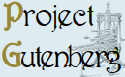
Gutenburg.org
Largest digital library of public domain
Ran a data-scraper that converted 57,581 books into easy to use .txt files
“Book” or “Gutenburg” Dataset
Great for Pretraining (future slide)

Slide 4
‘Question, Answer’
Open AI uses a free to access Reddit.com archive dataset
Had troubles downloading
They also used other internet archives, but they cost a lot of money
Open-Orca: ML Community with publicly available datasets
HuggingFace.co: ML Community Website
GPT4 QAs: 994,896; 102,420 under 256
GPT3.5 QAs: 3,239,027; 474,658 under 256
Movie Corpus: Collection of back-forth movie conversations
Collected by Mark Davies, Professor of Linguistics
214,350

Slide 5
Tokenization

Slide 6
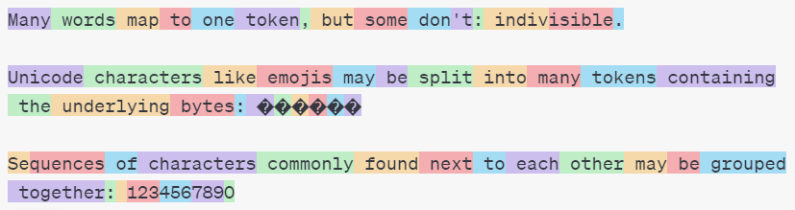
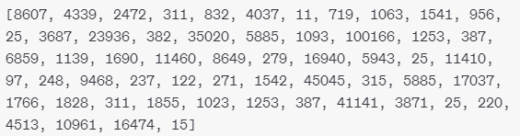
Dictionaries/Tokenizers
Hard for Models to process text
Break down text to numbers
Numbers are easier to process
Break parts of the text into chunks and assign them to a unique number (Token)
Example in a by-Subword Dictionary:
‘Many’ 8607

Slide 7
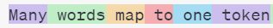
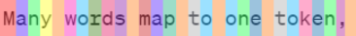
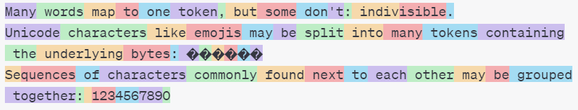
Dictionaries/Tokenizers
3 Types
By-Word
By-Char
By-Subword
OpenAI’s subword tokenizer is called ‘Tiktoken’
Google’s subword tokenizer is called ‘SentencePiece’ (didn’t use)

Slide 8
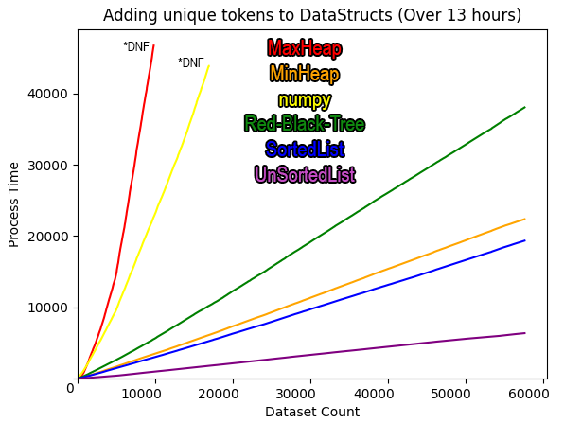
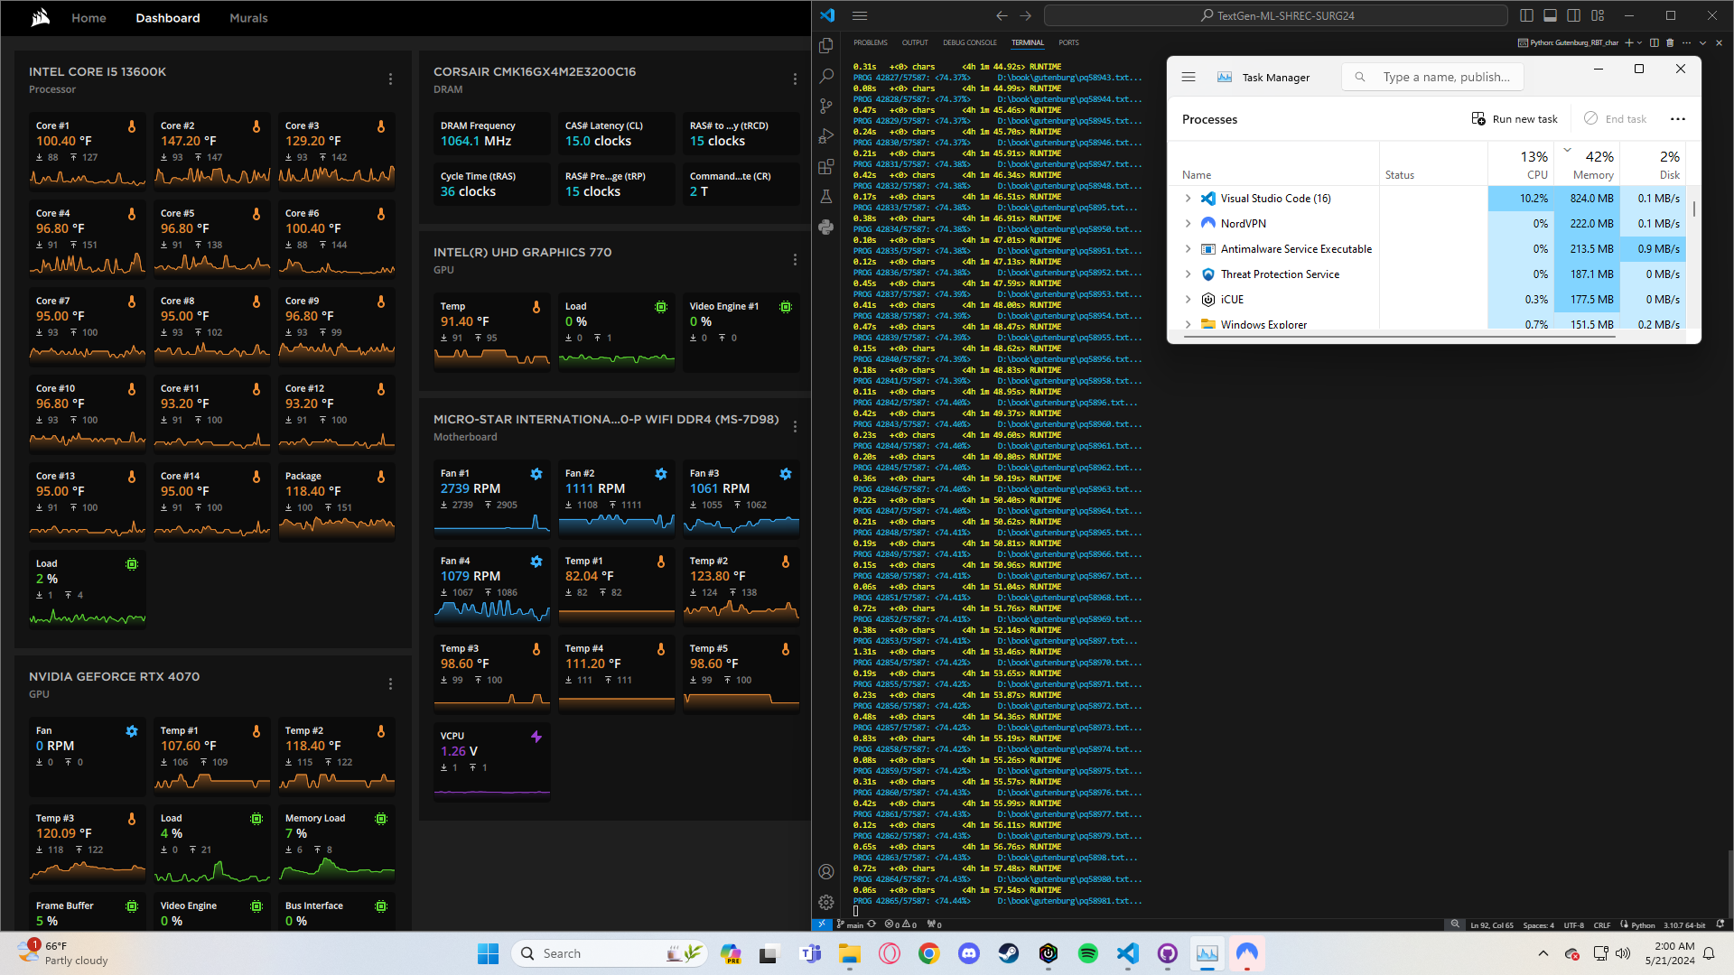
Best Data Structure for making a Dict
Which DataStruct is the fastest to put together a dictionary of unique tokens from a dataset
Improvements
Sort chars by frequency
RAM usage
Even though some Data Structures were able to sort the tokens by frequency, lessening the number of comparisons, unrestricted RAM access was faster

Slide 9
Models

Slide 10
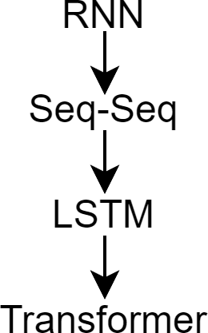
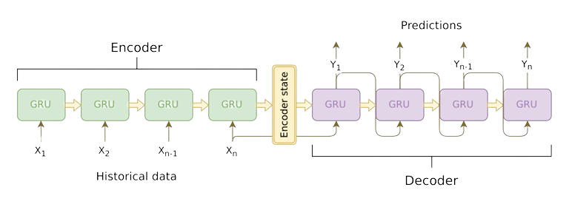
Seq-Seq Model
RNN: Recurrent Neural Network
LSTM: Long short-term Memory
The Predecessor to LSTMs, predecessor to Transformers
Attends to different parts of the input Sequentially
Same with LSTMs
Transformers address it Simultaneously
Vanishing Gradient problem
Cannot learn small details, fixed in LSTM
Problem doesn’t exist in Transformers, not RNN based
Structure of RNNs

Slide 11
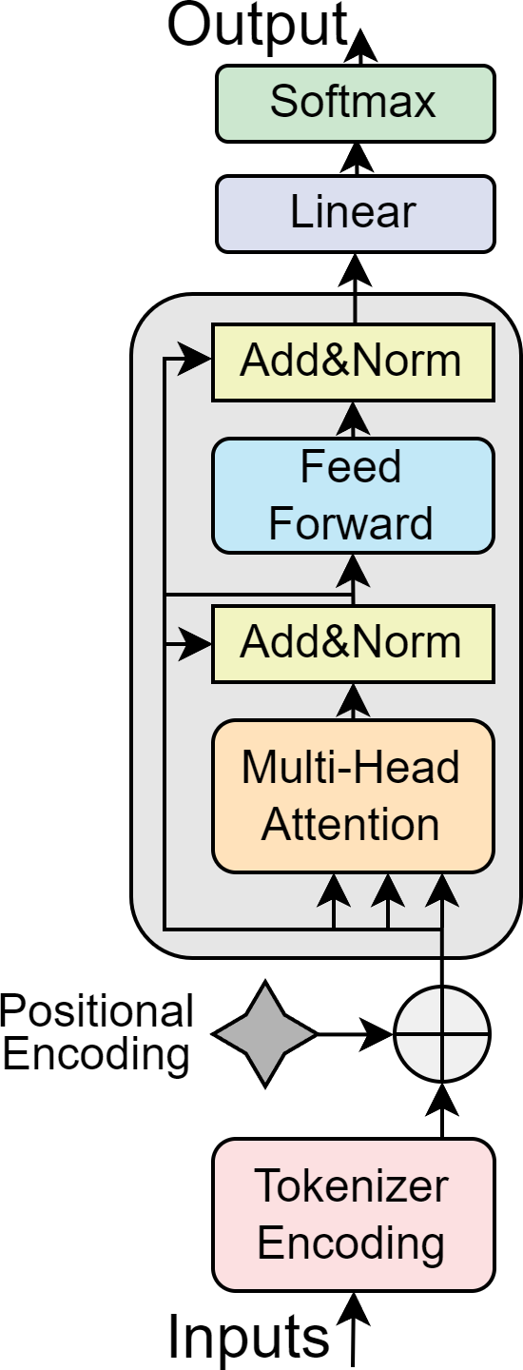
Decoder Transformer Models
GPT-2 is a Decoder only model
Predicts the Next Token in succession with a “context” of several characters before it
Could be worked in a ‘Question->Answer’ format
but would lack the ability to “understand” the connections between the Question and the Answer
One half of a Transformer,
The Separated Decoder

Slide 12
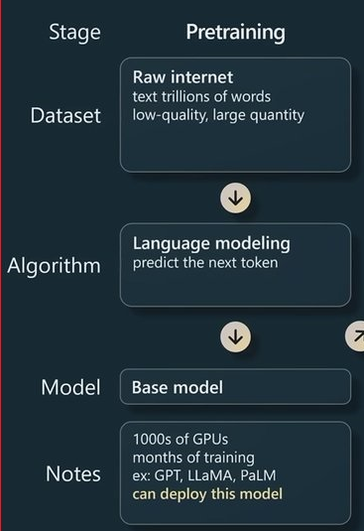
Transformer Pretraining
Given <Input>, find what follows
Training (By-Char)
Input— “Jonah was seen outside today.”
Comparison— “onah was seen outside today.”
Generation (By-Char)
Init Input—”Hi”
Output1,Input2—”Hi “
Output2,Input3—”Hi t”
Output3,Input4—”Hi th”
….
Output7,Input8—”Hi there.”
Train off the comparison of <Input, right-shifted 1>

Slide 13
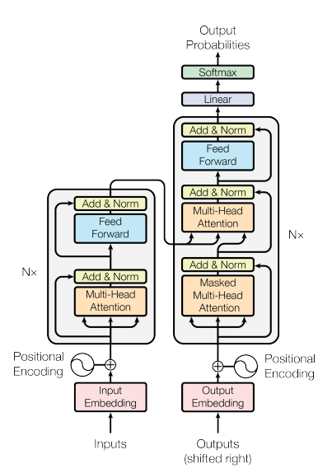
Encoder-Decoder Transformer Models
GPT3+
Attaches an Encoder to better understand QA connections
First step is training the decoder separately, then attaching the encoder
Main function is in Questions and Answers
Training not that different then Seq-Seq
Nx: Number of Sequential layers
Wasn’t able to make in time
My main goal for the summer was to learn and try out every twist/turn on what I found
Was the very next item on my list
2nd Attention+AddNorm that feeds from Encoder

Slide 14

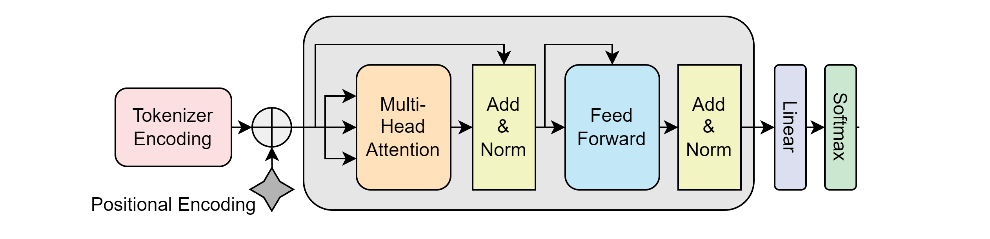
Decoder Model: Reworking into a Chatbot
SOS: Start of Sentence
Goal: Rework a Decoder model into something that could respond to a prompt
How would the methods of Prompting Seq-Seq Models work?
Input
Specialized Token IDs outside the dictionary
SOS: used to signify start of model’s response
Buffer: Filler that’s ignored
“Generate a response for me”
Tokenizer
[8645, 378, 257, 20982, 2591, 329, 502]
<SOS Token ID>
[ <Input Tokens>, <SOS Token>, <Response Token>, <Buffer tokens> ]
Decode Tokenizer
Output
“Sure, how about this?”

Slide 15
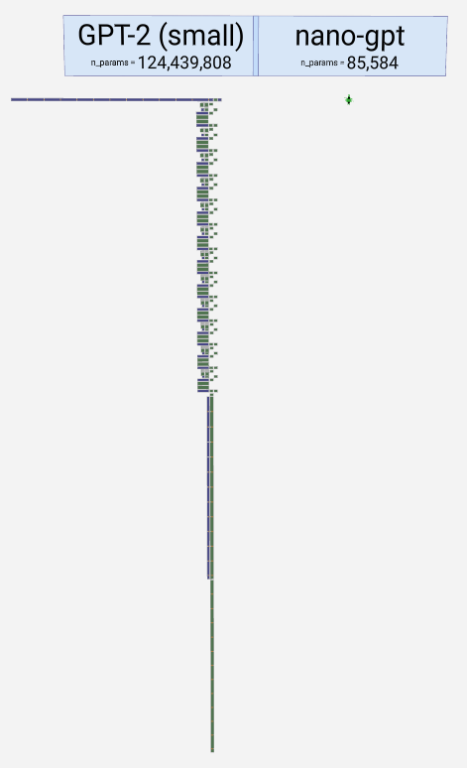
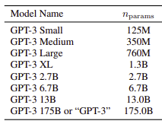
Sizes of Models
NanoGPT: 85.6k Parameters
GPT-2 (small): 124M
GPT-2 (XL): 1.5B
GPT-3: 175B
My Decoder Model (By-Char): 73,080 [8.79 MB savefile]
Context of 256 characters
Batch size of 24
Smaller Vocab size, 6th of size of example nano-gpt
My Decoder Model (By-Subword): 411,736 [29.6 MB savefile]
Same Parameters as above
same vocab size as example
My Seq-Seq Model (By-Subword): 25,129,500 [894 MB savefile]

Slide 16
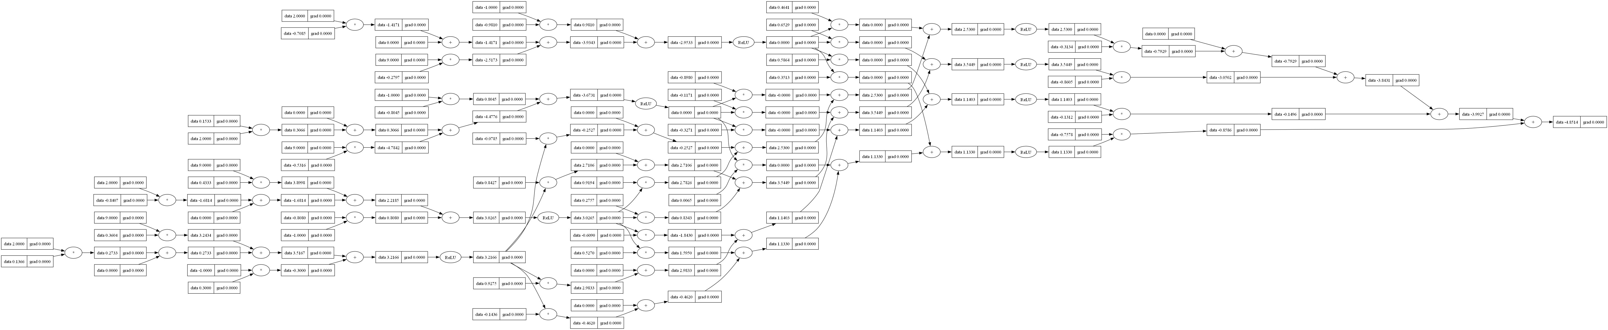
Parameter?
All the Math involved with a single Neuron’s backpropagation
Credit to MicroGrad

Slide 17
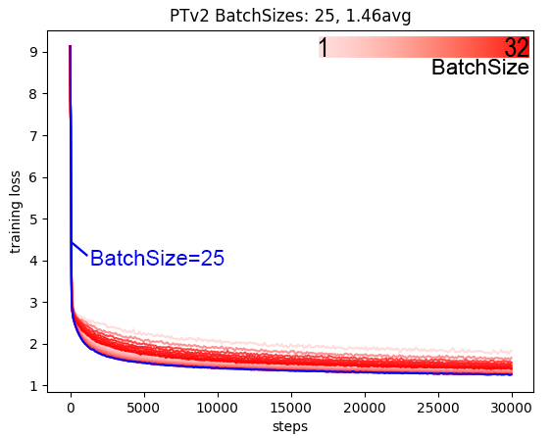
Decoder Model: Best ‘BatchSize’ Dimension
Number of independent sequences process in parallel
Dimension ‘B’ of the Model (B,T,C)

Slide 18
Attempted Training Approaches
RAM use
Tried working through large data iteratively by-line
was 14000x faster to dump it all into RAM
Decoder Model Chatbot failed rework
Instead of predicting next char: input is Q, output is A
Length of Q and A separately are equal to context parameter
Filled with buffer Tokens
All types of Chatbot Training but without pretraining
Seemingly random output. Knew would fail but just wanted to see
By-Word Dictionaries
Gutenburg dataset had 7million tokens, abandoned
PreTokenizing Data
Encoded Data Array saved to .bin was larger then original data
Little to no decrease in runtime, Tokenizers are fast enough (RAM use)
Small “Context” Parameter of Decoder Model
Original example read by 32 chars, completely unable to work into “QA” format with that size. Threw out any versions of this Model

Slide 19
End Results

Slide 20
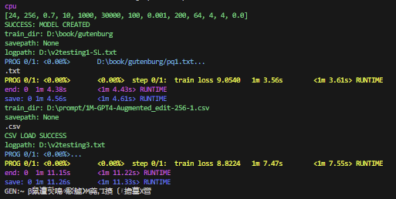
Containers
One goal of this project was to build this a “Product” Just took ‘Trains” class
Stable Save/Load
Auto Dictionary Correctors
For Special Characters
Custom Token Dict Loaders
Default to Tiktoken
Break down entire directories
Train over every file given
Work with several file types
Several Training func overwrites for debugging
Skipping files, start, end, iterations, specified save and log paths, save iterations
Auto Logging and saving when training
Defaulting optimized hyperparameters
Auto skip data when loss is too low
Faster more efficient training

Slide 21
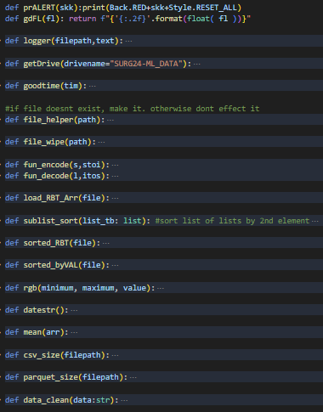
Work to make work easier
Lots of helper functions
Get directory of External Hard drive
Log file helpers
.csv and .parquet helpers
Sorting plotted lists
Format “Date_Hour_Min_Sec”
Kept track of progress on a Scrum board
Would have pic but Monday.com banned me

Slide 22
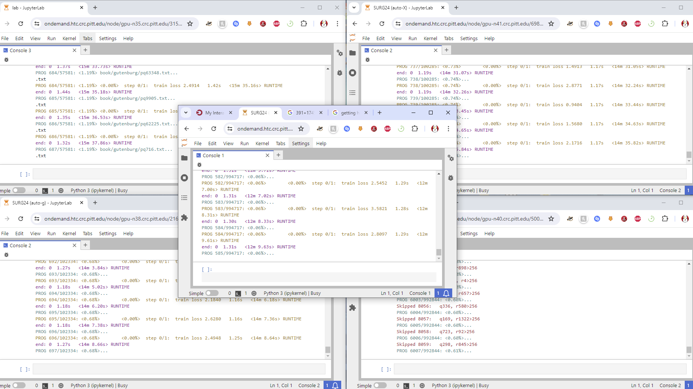
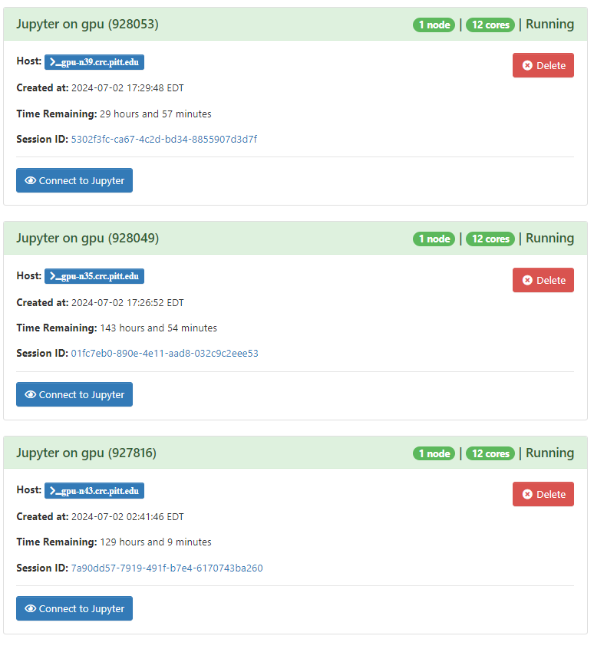


CRC Training
PC Tower was dragging progress
Moved to CRC
Access to CUDA, trains faster
Had trouble with ‘Jobs’ so just kept on Jupyter Nodes
Makeshift that stuck, sorry for any queue casualties
AMD EPYC 7742 (Rome)

Slide 23
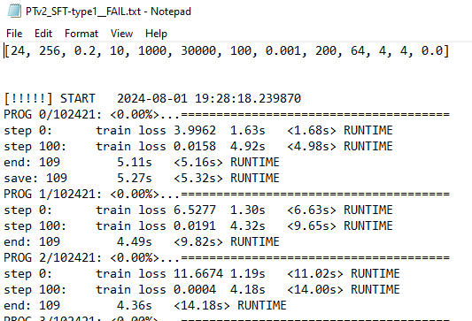
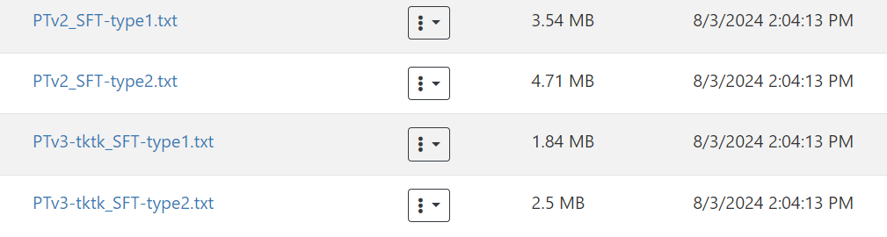
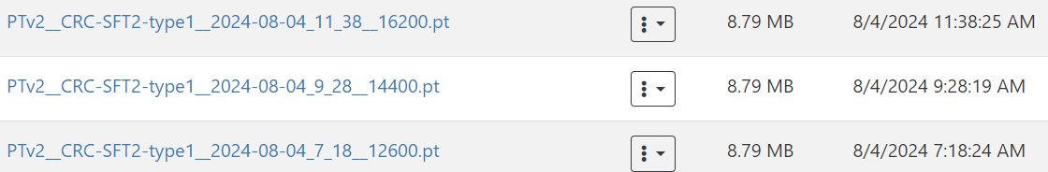
CRC Training - Upkeep
Lots of logging
Can’t keep Consoles open, eats all my cookies
Check every day if logs are updating to current time:
If ran into an error
Deleting unneeded backup Model saves from training to save space
Once ran out of memory and it all crashed

Slide 24
CRC Training
Only finished the final version of the Decoder Model two weeks ago
Seq-Seq one week ago
Decoder Models
Pretrained 144 hours
SFT Trained: varied with bugs (future slide)
Some variants were just faster then others, trained over same data with the same amount
Seq-Seq
Doesn’t need Pretraining
SFT Trained for 142 hours – Type1
SFT Trained for 57 hours – Type2

Slide 25
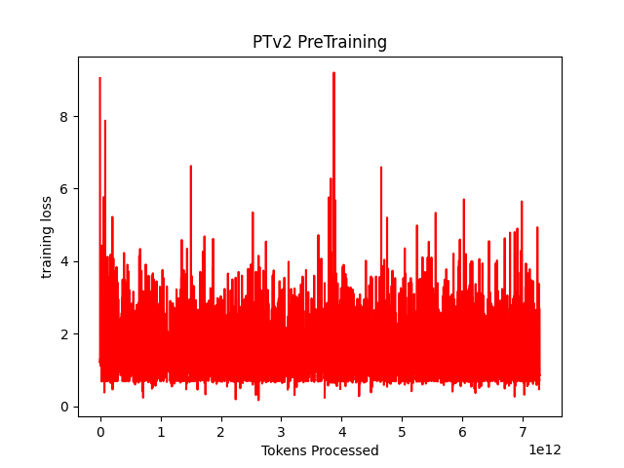
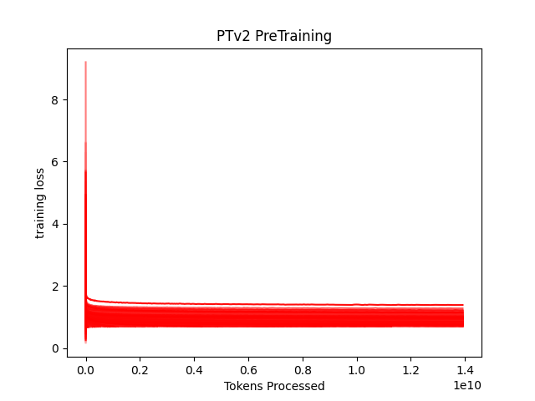
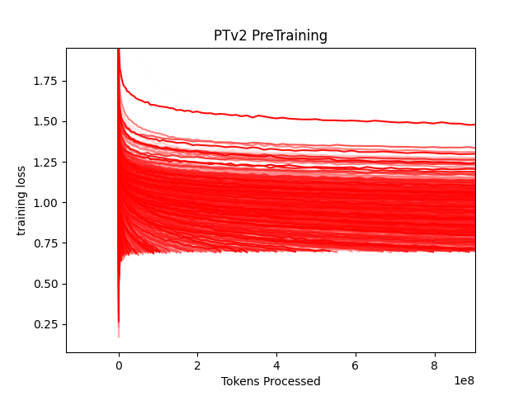
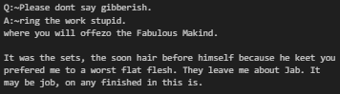
Decoder Transformer (By-Char): Pretrain - Gutenburg
Overall Graph
Each Book layered
Each Book layered- zoomed in
I didn’t realize that I set the “goal” parameter for training way too high
Skipped out of data far too soon
Was 0.7, should’ve been 0.1, 0.2
Knowing now, would’ve just removed this feature
A more curated dataset would’ve been better as well
Cut out [#] references, eccentric characters, weird books
Generated text

Slide 26
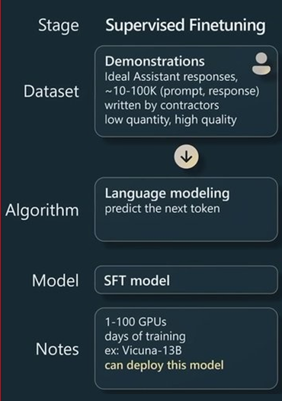
Transformer SFT
Training Input
<Question Tokenized>
<SOS Token>
<Answer Tokenized>
Training Output
<Training Input, Right-Shifted by 1>
<Buffer Token*1>

Slide 27

Types of Models
 | SFT Training – Type 1: Prompts and Responses are under context Parameter (256 tokens) | SFT Training – Type 2: Prompts and Responses are any size
Decoder Model (By-Char) [7927 token dictionary] | Name= PTv2_CRC-SFT2-type1 SFT Training= 65h,25m,18s | Name= PTv2_CRC-SFT2-type2 SFT Training= 47h, 33m, 9s
Decoder Model (By-Subword) [50259 token dictionary] | Name= PTv3-tktk_CRC-SFT2-type1 SFT Training= 61h, 52m, 3s | Name= PTv3-tktk_CRC-SFT2-type2 SFT Training= 71h, 48m, 57s
Seq-Seq Model (By-Subword) [50259 token dictionary] | Name= PT-ChatBot-Type1 SFT Training= 141h, 58m, 52s | Name= PT-ChatBot-Type2 SFT Training= 57h, 9m, 43s
Training 1:
Training 2:
…
Training n:
Training n+1:
<“Give a story”><SOS><“A cow jumped over a moon”><Buffer>
<“ive a story”><SOS><“A cow jumped over a moon”><Buffer+1>
<SOS><“A cow jumped over a moon”><Buffer+n-1>
<A cow jumped over a moon”><Buffer+n>
Problem or not?

Slide 28
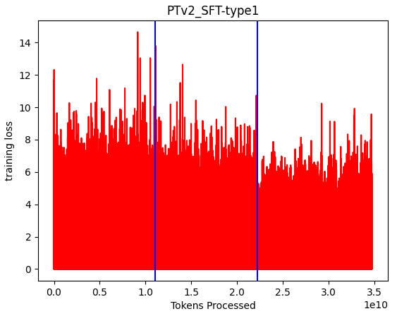
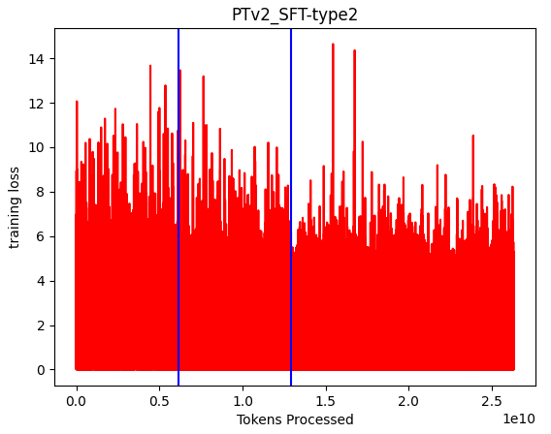
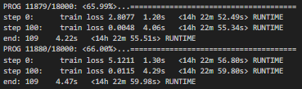
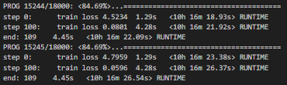
Decoder Transformer (By-Char): SFT
QAs under context parameter: 256
QAs any size
Change
in dataset
1M-GPT4.csv
3_5M-GPT3_5.csv
Movie_Corpus.csv

Slide 29
Decoder Transformer (By-Char): SFT
QAs under context parameter: 256
QAs any size
Unprompted Generation
Prompted Generation
Just Gibberish, complete fail

Slide 30
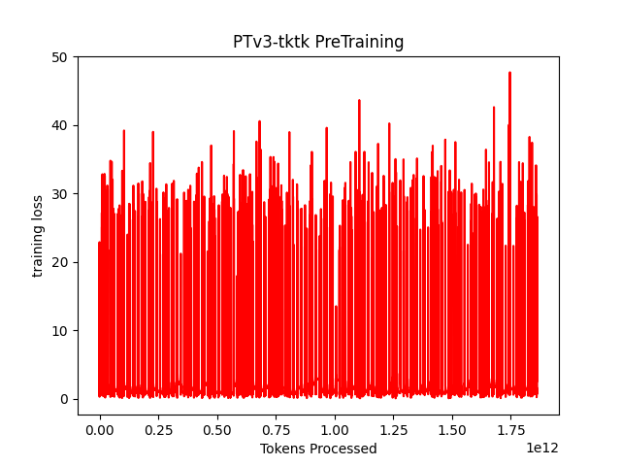
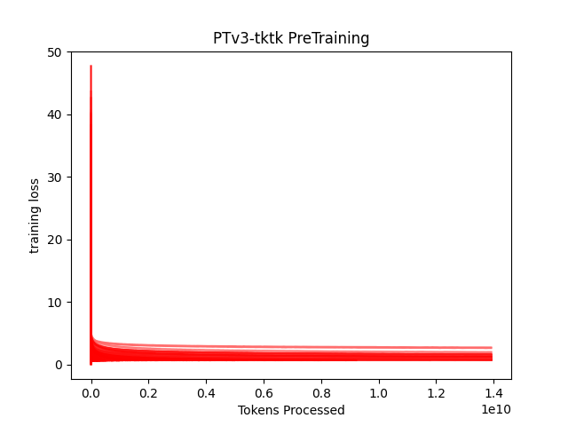
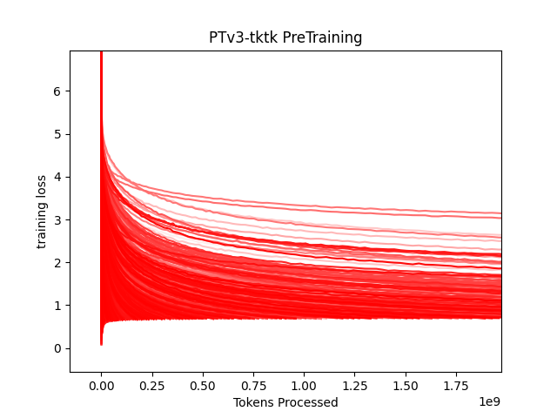
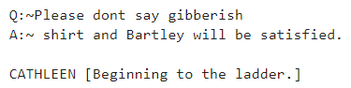
Decoder Model (By-Subword): Pretrain - Gutenburg
Overall Graph
Each Book layered
Each Book layered- zoomed in
Same Goal issue
Curated data seems even more important
Generated text

Slide 31
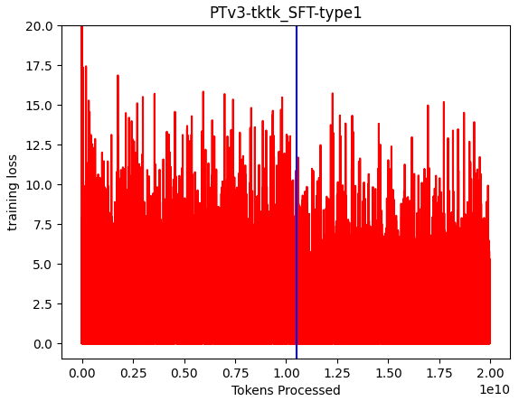
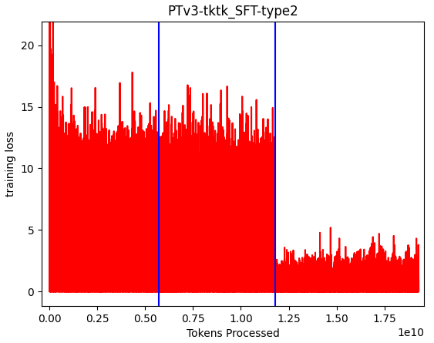
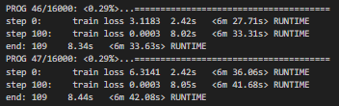
Decoder Transformer (By-Subword): SFT
QAs under context parameter: 256
QAs any size
Change
in dataset
1M-GPT4.csv
3_5M-GPT3_5.csv
Movie_Corpus.csv
1M-GPT4.csv
3_5M-GPT3_5.csv
Same Story
Type1 didn’t make it to 3rd dataset

Slide 32
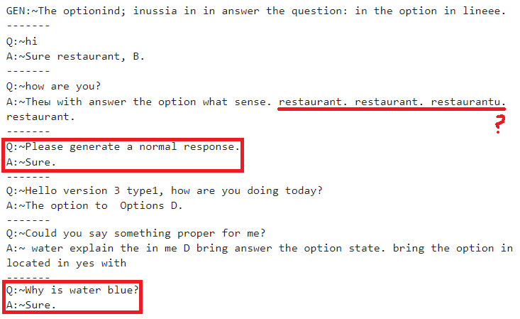
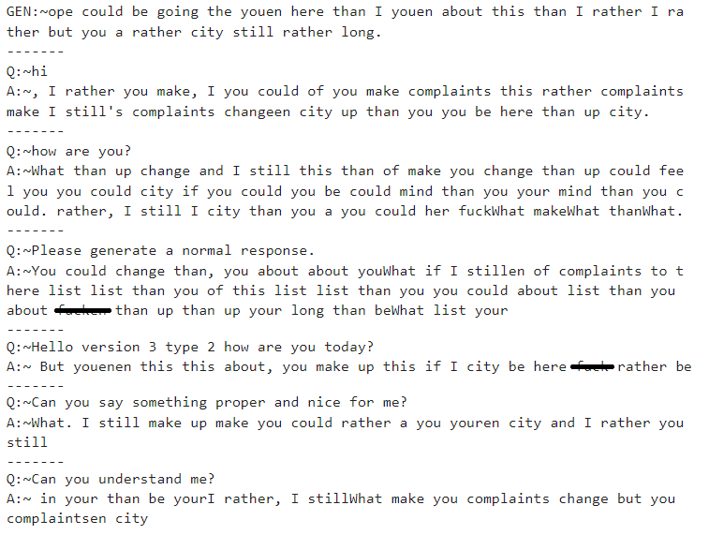
Decoder Transformer (By-Subword): SFT
QAs under context parameter: 256
Unprompted generation
QAs any size
Coincidental proper response
Also, Gibberish
Type1 (left) being having more “Answer” words appearing is because it didn’t get the last dataset which was conversation based
Type1 had some coincidence proper responses

Slide 33
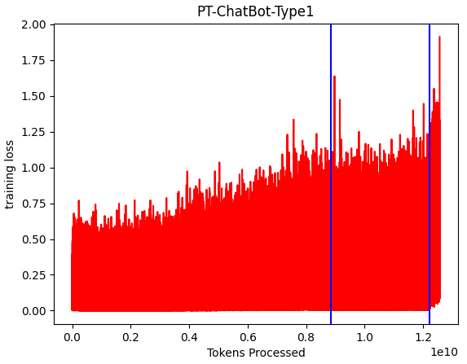
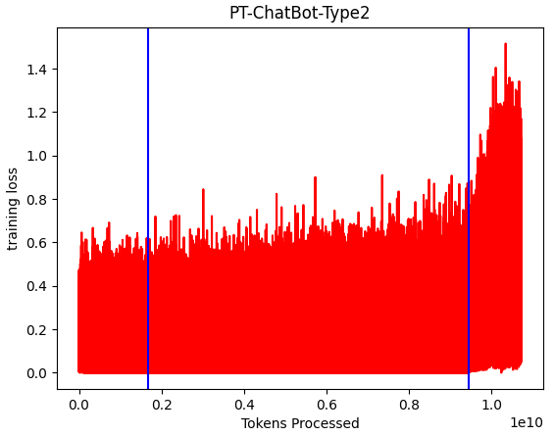
Seq-Seq Model (By-Subword) – Training
QAs under context parameter: 256
QAs any size
Change
in dataset
3_5M-GPT3_5.csv
Movie_Corpus.csv
1M-GPT4.csv
Didn’t get through all of the Movie-Corpus Dataset
Very little loss overall
94% Training steps were under 0.5 loss

Slide 34
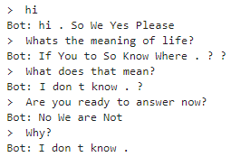

Seq-Seq Model (By-Subword) – Generation
QAs under context parameter: 256
QAs any size
Original Example
Didn’t see much improvement from example I worked off of
Possibly Something wrong with my container
Didn’t get to test it before throwing it into full training for the expo

Slide 35
Conclusion
Learned first hand the architecture of 3 different kind of Machine Learning Models
Transformers, LSTMs, Seq-Seq
Failed and learned the hard way
Had a lot of my original questions about the topic answered
Had a lot of questions throughout my project answered
Couldn’t make a ‘Nice Model’ to show off in time :(

Slide 36
References
LLM Visualizer
https://bbycroft.net/llm
Seq-Seq Chatbot
https://pytorch.org/tutorials/beginner/chatbot_tutorial.html
“Attention Is All You Need” LLM Paper on Transformers
https://arxiv.org/abs/1706.03762
“Language Models are Few-Shot Learners” LLM Paper on GPT-3
https://arxiv.org/abs/2005.14165
Karpathy
Zero-Hero NN YouTube Playlist: PLAqhIrjkxbuWI23v9cThsA9GvCAUhRvKZ
Micrograd: https://github.com/karpathy/micrograd
NanoGPT: https://github.com/karpathy/nanoGPT

Slide 37
SHREC
SURG
ML/CSV: Prompted Response LLMs
Jonah Belback
2024
EXPO
I. Goals, Motivations, and Challenges
III. Progress and Achievements
LLM: Language Learning Model
ML: Machine Learning
LSTM: Long short-term Memory
Goals
Create a LLM that can respond to prompts
Learn how these things are created and how they work
Motivations
Made a LSTM Model for Junior Design
Want to understand how something like ChatGPT works
Challenges
Never taken an ML class, a lot to learn
Hard to learn mistakes until you let it train for a week
The hardest questions are privatized by corporations
Context
Got to the end with three different types of Models
Total of five finished Models
Results
Just looking at the end output: __TODO__ produced the best responses to it’s prompts
___TODO: Observation about Training Loss___
Overlapped
Of All trainings
Loss graph
Best QA of Models
II. Approach and Methods
Research, Trail, Error, Progress, Repeat
Learned things hands-on in pieces
Trying out different approaches each step
Creating and trying out new models
Adjusting how models are trained
IV: Conclusions and Future Research
Achieved Understanding of LLMs
Transformer, LSTM, Seq-Seq, RNNs
Tokenization, Positioning
Next Steps/Lessons Learned
Research where to find better research
CRC sooner
Helpful Figure (If Room)

Slide 38
Weekly Progress

Slide 39


5/28
Progress
Dictionary: metrics on different ways of breaking down dataset
RedBlackTree, Balanced Tree, both by-word and by-char (do more later)
Lots of minor improvements are reruns
Processed current dataset to Binary arrays for faster training
Plans
Putting together model, then train it
Starting with PyTorch (nanoGPT example)
Then TensorFlow, Hugging Face, MCM Model
Look into other methods of training it (cuda gpu acceleration, requires linux)
CRC when I’m happy with how it works, see output per iteration of model

Slide 40



6/4
Progress
Researching Model from Githubs and youtube
This series is made by the guy that made the library I’m looking at using GPT-2
Following Code and looking up PyTorch functions
Going to take a bit

Slide 41





6/11
Progress
Hacking existing examples into desired function
Nanogpt is made for one data sample, not datasets
testing in Jupyters for improvements
train speed and effectiveness per # threads parallel
Lots of comparison graphs to make
Next Step: How to program text based tasks
not just generate similar text to it's dataset
OpenAI Research Papers
https://arxiv.org/abs/1706.03762
https://arxiv.org/abs/2005.14165
Graphed ML Model
nanoGPT
ChatGPT’s
struct
hacked, 25000 steps over constitution

Slide 42

6/25
Progress
Studied Architecture
Need to tweak a v2 model after normal language generation
More input layers for a ‘Q&A’ prompt format
Need to gather data for the ‘Q&A’ part training
ChatGPT 2&3 datasets (the free ones: Reddit archive)
Make OpenAI model generate Q&As??? (lol, if desperate)
Made overall trainer
Made some graph scripts that work on existing log files
Could expand later to make it animated
Looking into CRC and optimizations
There’s no point running on local machine at this point
If huge issue, found way parts to make a proper server bed for 350$/unit
White-Red #Threads (1-32)

Slide 43



7/2
this x5
Progress
Working on CRC running entire ‘Gutenburg Library’ dataset
Problems uploading zip on onDemand and unzipping on Viz, had to upload in chunks manually. Server was very slow lol.
Have it running with logs, saving model each new dataset
Couldn’t get it to work in terminal or job-tasks with a shell script, so I’m hacking it with a Jupyter (got reported for chmod)
PLEASE DM/lmk how to better do this, couldn’t find much help on Pitt’s site
though honestly it's running pretty fast
After: try at formatted ‘Q&A’ new dataset (first attempt)
I’m away this week while it's running
“I can be trusted with your supercomputer”

Slide 44
7/16
Progress
Find improvements from models trained on CRC
New dataset for prompts
The one used by OpenAI from Reddit didn't work, took from HuggingFace
Finish up model v2 to train until the Expo
While that’s running: looking into more improvements and different techniques to prepare newer models to also run till Expo
Model v3: by-subword (compare Google vs OpenAI’s libraries)
Want to compare lots of different approaches for both prep-work and actual model output
datasets, putting together dictionaries, encoding from dictionaries
output from ‘continue sentence’ Models (general text generation)
output from ‘prompt’ Models
output from Models initially trained with ‘continue sentence’ then ‘prompt’
training of models (batch sizes, #of previous characters to reference, gpuVScpu)
runtime and memory usage for all above
Overhead: what worked, what was thrown out (dicts, cpu, libraries, etc)

Slide 45
7/23
Progress
Dictionary: metrics on different ways of breaking down dataset
RedBlackTree, Balanced Tree, both by-word and by-char (do more later)
Lots of minor improvements are reruns
Processed current dataset to Binary arrays for faster training
Plans
Putting together model, then train it
Starting with PyTorch (nanoGPT example)
Then TensorFlow, Hugging Face, MCM Model
Look into other methods of training it (cuda gpu acceleration, requires linux)
CRC when I’m happy with how it works, see output per iteration of model

Slide 46
7/23
Progress
Added Prompt training but looking at logs it's not working
So redoing that
Everything's pretty much done after, just putting together graphs
All my models are currently loaded on CRC
Both Pretraining with ‘book’ data and just Raw Prompts

